Slide 1
Decision Support Systems
-Third Assignment-
Thiago da Silva Alves
Domenico Sacco

Slide 2
PRESENTATION INDEX
Sales Informations
Company profits through time
Data mining structures
Profits prediction
Highest demand products prediction

Slide 3
SALES INFORMATIONS
Best Customers
We define the best clients as those generating the highest revenues for adventure works.
Best Store clients
We define the best customer stores as those where highest revenues were generated.
Best products
Likewise, we define the best products as those generating the highest earnings for the company.

Slide 4
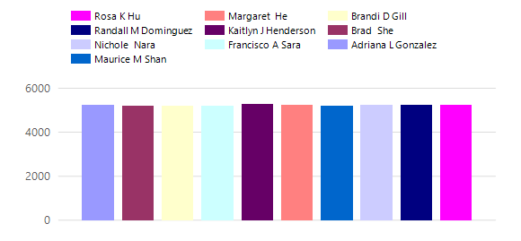
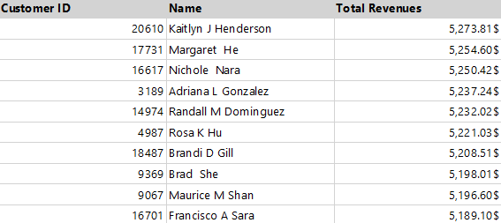
BEST CUSTOMERS

Slide 5
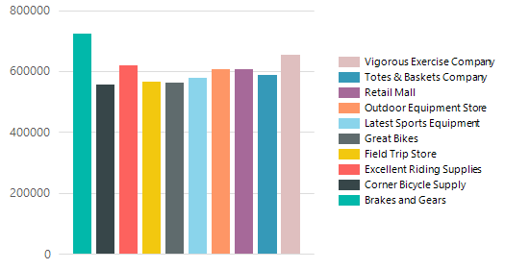
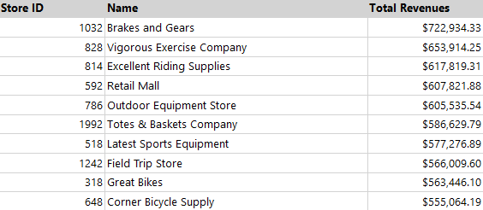
BEST STORE CLIENTS

Slide 6
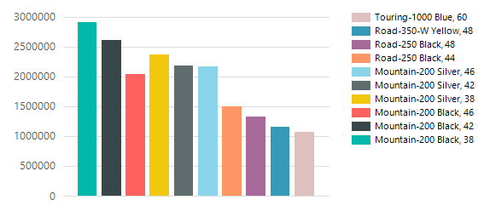
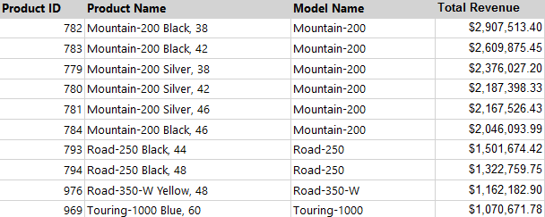
BEST PRODUCTS

Slide 7
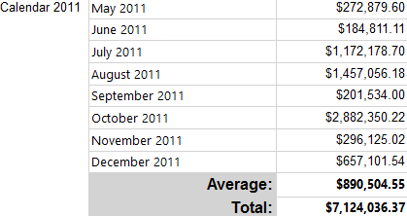
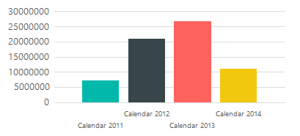
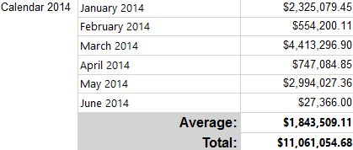
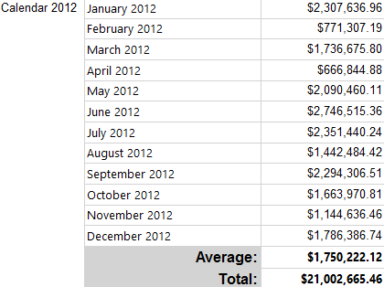
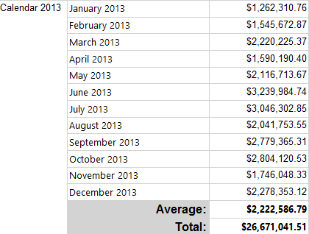
COMPANY REVENUES PER MONTH THROUGH TIME

Slide 8
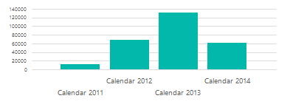
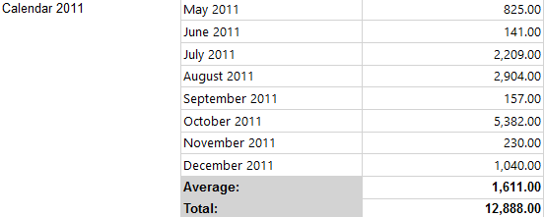
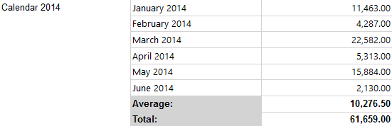
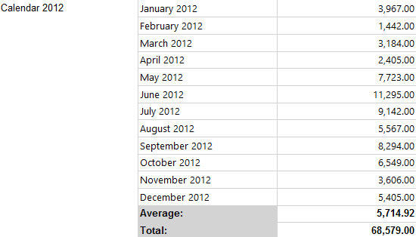
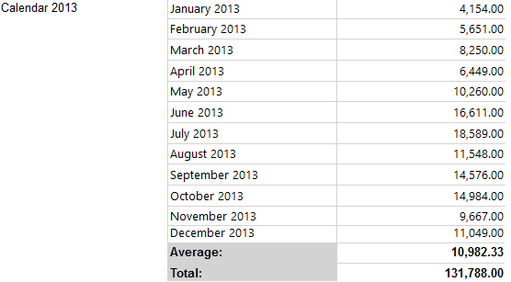
ORDER QUANTITY THORUGH TIME

Slide 9
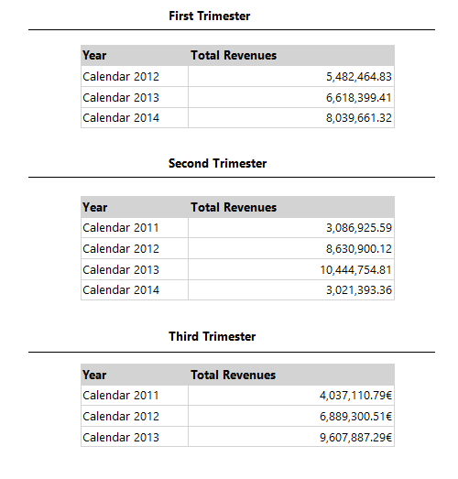
COMPANY REVENUES PER TRIMESTERS

Slide 10
DATA MINING STRUCTURES USED
vPredictOrder.dmm
It is a time series to predict the total sales quantity in the next three months of the products having the highest demand.
PredictProfits.dmm
The purpose of this mining structure is to predict the profits of the top products in the next three months.

Slide 11
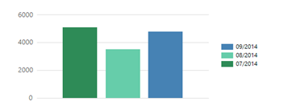
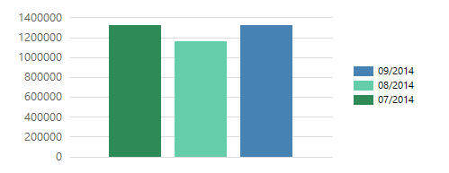
PROFITS AND QUANTITY PREDICTION
QUANTITY PREDICTION
PROFITS PREDICTION

